Slide 1
Ring Embedding in Faulty (n, k)-star Graphs
Jung-Hwan Chang
2001 IEEE 99-106
Presenter: Chiao-Wei Chiu (邱喬偉)
Date: July 18, 2007

Slide 2
Abstract
In this paper, we consider the ring embedding problem in faulty (n, k)-star graphs. An (n, k)-star graph is recently proposed as an attractive interconnection network topology and also known as the generalized version of an n-star graph with scalability such that the number of nodes in the graph can be suitably adjustable by two dimensioning parameters n and k. Our scheme is proceeded in top-down style in such a manner that the resulting sub-stars maintain evenly distributed faults. We show that a ring of length n!/(n - k ) ! - f can be found in an (n, k)-star graph having n!/(n - k)! nodes when the number of faulty nodes f is at most n - 3 and n - k ≧ 2.

Slide 3
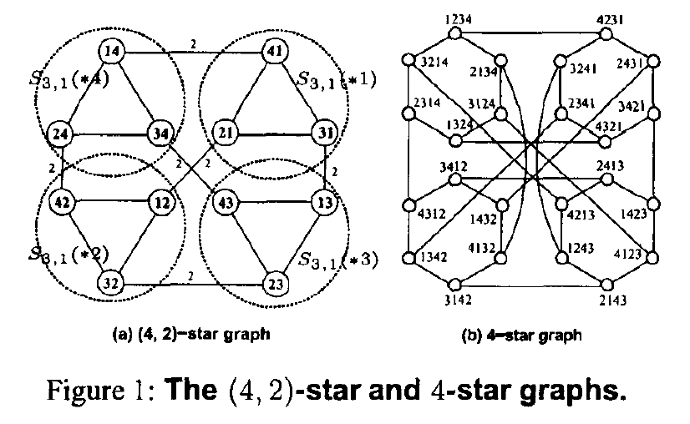
Basic Notations

Slide 4
Definitions
(n - k + l, l)-sub-star
adjacent
d_{m}-expansion
For instance, let us consider a (5,2)-sub-star X = (21 * *5)₈ in S_{8,5}. Then, after applying the 4-expansion on X, we get the following five number of (4,1)-sub-stars: A=(21*35)₈, B=(21*45)₈, C=(21*65)₈, D=(21*75)₈, and E=(21*85)₈.
A and B are adjacent and
difS(A, B) = 3 , difS(B, A) = 4.

Slide 5
Properties
An (n, n - 1)-star graph S_{n,n-1} is isomorphic to the n-star graph S_{n}
Lemma 1:
An S_{m,1} is isomorphic to K_{m}, where K_{m} means the complete graph of m nodes and m(m - 1)/2 edges

Slide 6
Super Ring
If the (n - k + l ,l)-sub-star X_{i} is adjacent to its two neighbors X_{(i-1)} and X_{(i+l)}
  For example, R = [(***3*2)₈, (***1*2) ₈, (***4*2)₈ ,(***4*5) ₈, (***3*5) ₈] is a (6,4)-super-ring in S_{8,6}

Slide 7
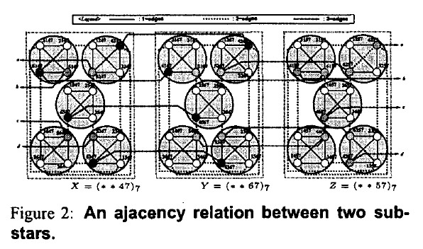
Observation 1
All sub-stars in X are fully connected each other within X and those in Y too in terms of adjacency. Moreover, all sub-stars in X except one, that is x, have connections to the corresponding sub-star in Y in the one-to-one fashion.

Slide 8
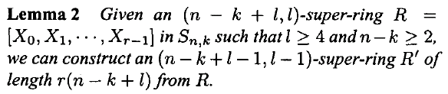
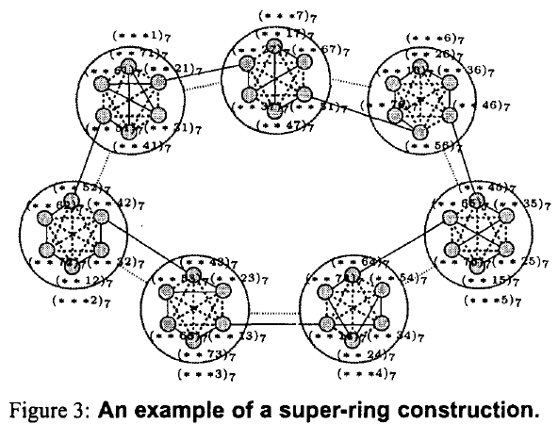

Slide 9
Observation 2
The more the gap between n and k in an (n, k)-star graph, the larger complete graph is contained within the graph as a sub-graph.

Slide 10
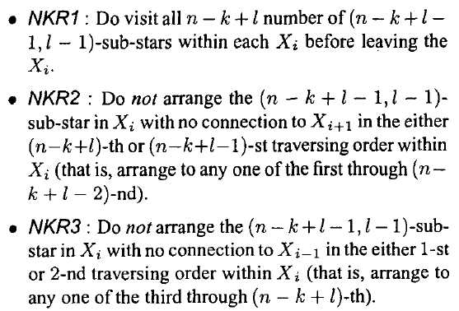
Rules

Slide 11
Theorem
If an S_{n,k} with f faulty nodes satisfies such condition that f ≦ n - 3 when n - k ≧ 2, then we can always find a fault-free ring of length n!/(n - k)! - f in the S_{n,k}.

